Slide 1
Supermarket sales analysis
From January to March 2019

Slide 2
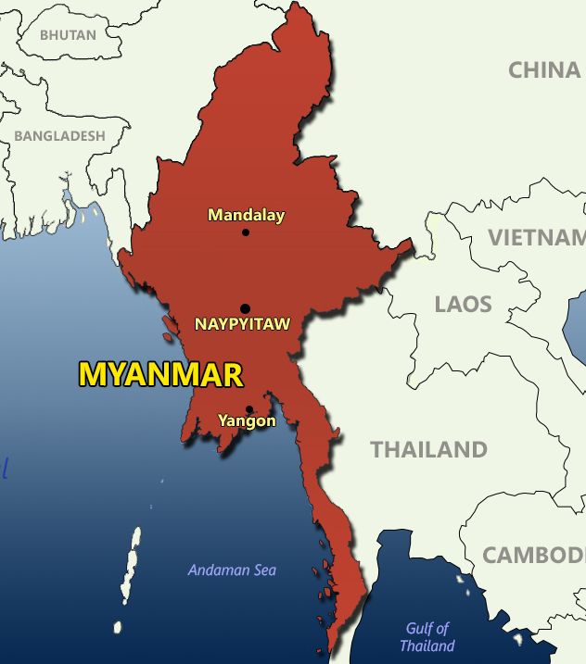
Supermarket location
Country: Myanmar.
Cities: Yangon, Naypyitaw, Mandalay.
Branches: A, in Yangon; B, in Mandalay; C, in Naypyitaw.

Slide 3
Overall stats
5510 items sold
$322,966.75 in sales.
$15,379.37 in revenue.
6.97 average customer stratification rating.
6 items bought per purchase.
$322.97 spent per purchase.
$15.38 in revenue per purchase.

Slide 4
Customer stratification ratings
Minimum value: 4.
Maximum value: 10.
Ranges:
Low-value (4 – 6).
Medium-value (6 – 8).
High-value (8 – 10).

Slide 5
Issues
Sales tend to decrease each month.

Slide 6
Issues
Sales tend to decrease each month.

Slide 7
Issues
Revenue tends to decrease each month.

Slide 8
Issues
Revenue tends to decrease each month.

Slide 9
Issues
The average customer stratification rating also tends to decrease.

Slide 10
Issues
The average customer stratification rating also tends to decrease.

Slide 11
Issues
Sales and revenue are decreasing.
The average client is a mid-value client.
The decreasing customer stratification rating average means that clients are losing value.

Slide 12
Approaches
Analyze customer behavior and create segments.
Use the client segment information to create customer profiles.
Use the customer profiles to create strategies to maintain high-value customers and to also increase the value of mid and low-level customers.
Use the customer profiles to train the staff accordingly so they know how to properly treat different types of customers.

Slide 13
Behavior analysis by customer value
Most members are high and low-value customers.

Slide 14
Behavior analysis by customer value
Most non-members are medium-value customers.

Slide 15
Behavior analysis by customer value

Slide 16
Behavior analysis by customer value
Most customers in Mandalay and Yangon are medium-value.

Slide 17
Behavior analysis by customer value
Most customers in Naypyitaw are high-value.

Slide 18
Behavior analysis by customer value
The most mid-value customers can be found in Mandalay.

Slide 19
Behavior analysis by customer value

Slide 20
Behavior analysis by customer value
Most women are medium-value customers.

Slide 21
Behavior analysis by customer value
Most men are medium-value customers.

Slide 22
Behavior analysis by customer value

Slide 23
Behavior analysis by customer value
Medium-value customers buy mainly electronic and fashion accessories and sports and travel items. Electronic accessories are the best-seller amongst them.

Slide 24
Behavior analysis by customer value
Low-value customers buy the most home and lifestyle items. Also, the best-selling product line amongst them is electronic accessories.

Slide 25
Behavior analysis by customer value
High-value customers buy the most food and beverages and health and beauty products, with the first category being the best-seller amongst this group.

Slide 26
Behavior analysis by customer value

Slide 27
Behavior analysis by customer value
Cash and e-wallet are mainly used by medium-value customers.

Slide 28
Behavior analysis by customer value
Credit card users are mostly high-value customers.

Slide 29
Behavior analysis by customer value
Low-value customers mostly use e-wallet.

Slide 30
Behavior analysis by customer value

Slide 31
Behavior analysis by customer value
High-value customers buy more items from Sunday to Tuesday, buying more on Tuesday than any other day.

Slide 32
Behavior analysis by customer value
Low-value customers buy more items on Wednesday.

Slide 33
Behavior analysis by customer value
Medium-value customers do most of their purchases from Thursday to Saturday. They buy the most items on Saturday.

Slide 34
Behavior analysis by customer value

Slide 35
Behavior analysis by customer value
All clients tend to make their purchases in the afternoon. Medium-value customers buy the most in the afternoon.

Slide 36
Behavior analysis by customer value
Most purchases in the evening are made by high-value clients.

Slide 37
Behavior analysis by customer value
Most purchases in the morning are made by medium-value customers.

Slide 38
Behavior analysis by customer value

Slide 39
Behavior analysis by customer value
Low-value customers bought the most items in January.

Slide 40
Behavior analysis by customer value
High-value customers bought the most items during February.

Slide 41
Behavior analysis by customer value
Medium-value customers bought the most items during March.

Slide 42
Behavior analysis by customer value
The number of items bought by both low and high-value customers tends to decrease.

Slide 43
Behavior analysis by customer value
Medium-value customers tend to purchase more items over time.

Slide 44
Areas of opportunity
Most sales come from medium-value customers. The goal would be to make them high-value customers. Since sales by medium-value customers are increasing, this may mean that medium-value customers are gaining value.
The tendency of increasing item sales by medium-value customers may equally mean that low-value customers are gaining value and that high-value customers are losing value or that there’s a client loss.
There’s a need to retain high-value customers, to keep increasing the value of low-value customers and to attract new customers.

Slide 45
Customer profiles based on their value
Category | Customer value
 | Low | Medium | High
Client type | Member | Normal | Member
City | Mandalay | Mandalay or Yangon | Naypyitaw
Gender | Female | Male | Female
Product line (top 3) | Electronic accessories, home and lifestyle, food and beverages | Electronic accessories, fashion accessories, sports and travel | Food and beverages, health and beauty, fashion accessories
Payment type | E-wallet | Cash | Credit card
Day (top 3) | Wednesday, Saturday, Tuesday | Saturday, Thursday, Friday | Tuesday, Sunday, Monday
Time of the day | Afternoon | Afternoon | Afternoon

Slide 46
Plan of action
Create strategies based on the profiles made according to the customer values.
Use the shared characteristics between each customer value profile to simplify the strategy creation process. For example, both low and high-value customers tend to be women with a membership that buy food and beverages and that come to the stores on the afternoon.

Slide 47
Other useful segmentations
Category | City
 | Yangon | Naypyitaw | Mandalay
Client value | Medium | Medium | Medium
Client type | Normal | Member | Normal
Gender | Male | Female | Male
Product line (top 3) | Home and lifestyle, sports and travel, electronic accessories | Food and beverages, fashion accessories, electronic accessories | Sports and travel, health and beauty, electronic accessories
Payment type | E-wallet | Cash | E-wallet
Day (top 3) | Sunday, Tuesday, Saturday/Friday | Saturday, Tuesday, Friday | Saturday/Tuesday, Thursday, Sunday
Time of the day | Afternoon | Afternoon | Afternoon

Slide 48
Other useful segmentations
Category | Customer type
 | Normal | Member
Client value | Medium | Medium
City | Yangon | Naypyitaw
Gender | Male | Female
Product line (top 3) | Electronic accessories, fashion accessories, food and beverages | Food and beverages, sports and travel, home and lifestyle
Payment type | E-wallet | Credit card
Day (top 3) | Saturday, Friday, Thursday | Tuesday, Saturday, Wednesday
Time of the day | Afternoon | Afternoon

Slide 49
Other useful segmentations
Category | Gender
 | Male | Female
Client value | Medium | Medium
Client type | Normal | Member
City | Yangon | Naypyitaw
Product line (top 3) | Health and beauty, electronic accessories, food and beverages | Fashion accessories, food and beverages, home and lifestyle
Payment type | E-wallet | Cash
Day (top 3) | Wednesday, Saturday, Thursday | Tuesday, Saturday, Monday
Time of the day | Afternoon | Afternoon

